Slide 1
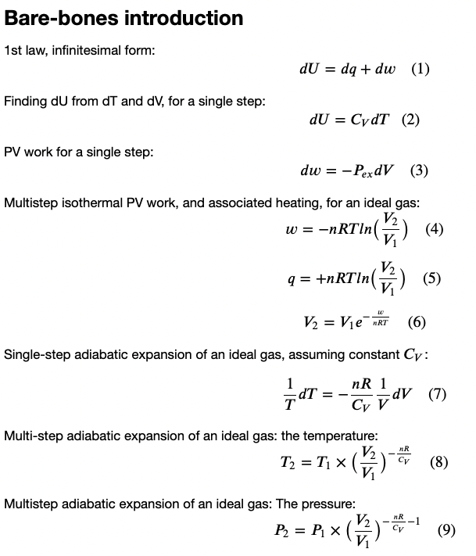
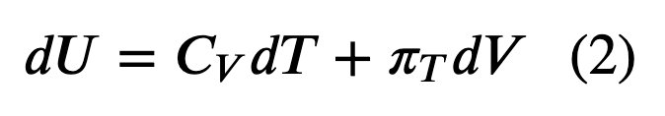
Last time …

Slide 2

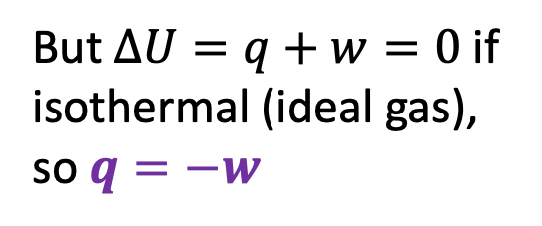





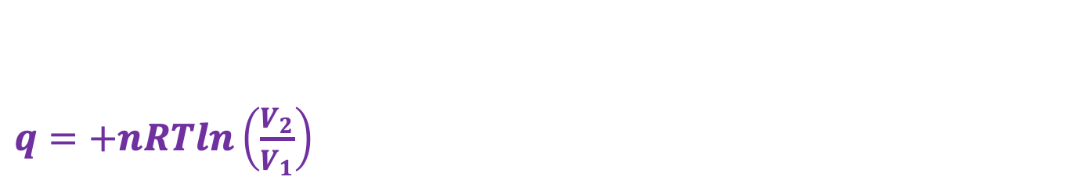




q for an isothermal expansion of an ideal gas
$$P_{ex}$$
$$P_{ex}$$
$$P_{ex}$$
$$P_{Ideal}=nRT/V$$
$$P_{2},V_{2}$$
$$P_{1},V_{1}$$
$$V_{1}$$
$$V_{2}$$
$q=+nRTln\left(\frac{V_{2}}{V_{1}}\right)$
$w=−nRTln\left(\frac{V_{2}}{V_{1}}\right)$
But $∆U=q+w=0$ if isothermal (ideal gas), so $q=−w$
$$U(T,V)$$
V
T

Slide 3
q for an isothermal expansion of an ideal gas
1st Law
+ideal gas

Slide 4
Algebra will get you the rest of the way (Friday)
1st Law
+ideal gas
algebra

Slide 5


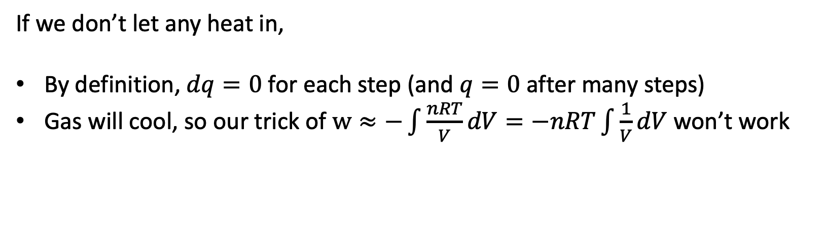
Adiabatic expansion of an ideal gas
$$P_{ex}$$
$$V$$
If we don’t let any heat in,
By definition, $dq=0$ for each step (and $q=0$ after many steps)
Gas will cool, so our trick of $w≈−\int{\frac{nRT}{V}dV}=−nRT\int{\frac{1}{V}dV}$ won’t work

Slide 6

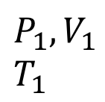
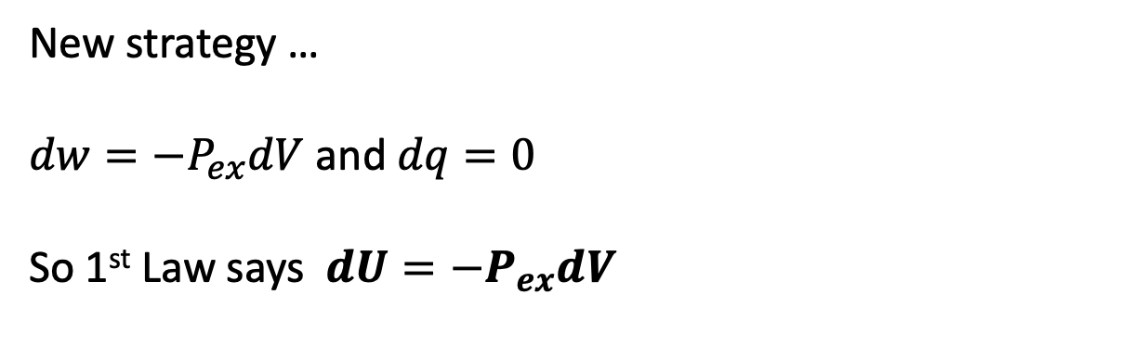






Single-step adiabatic expansion of an ideal gas
New strategy …
$dw=−P_{ex}dV$ and $dq=0$
So 1st Law says $dU=−P_{ex}dV$
$$U(T,V)$$
V
$$P_{ex}$$
T
$$P_{ex}$$
$$P_{2},V_{2}$$
$$T_{2}$$
$$P_{1},V_{1}$$
$$T_{1}$$
$$P_{ex}$$
No heat going in/out
Temperature is going down
$$dV$$
$$V$$

Slide 7
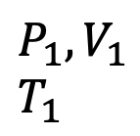
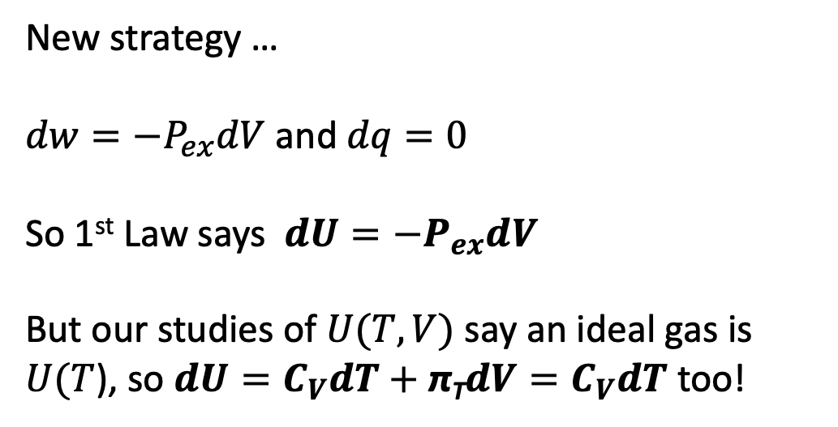



Single-step adiabatic expansion of an ideal gas
New strategy …
$dw=−P_{ex}dV$ and $dq=0$
So 1st Law says $dU=−P_{ex}dV$
But our studies of $U(T,V)$ say an ideal gas is $U(T$), so $dU=C_{V}dT+$ π_{T}$dV=C_{V}dT$ too!
$$U(T,V)$$
V
$$P_{ex}$$
T
$$P_{ex}$$
$$P_{2},V_{2}$$
$$T_{2}$$
$$P_{1},V_{1}$$
$$T_{1}$$
$$P_{ex}$$
No heat going in/out
Temperature is going down
$$dV$$
$$V$$

Slide 8

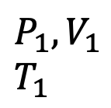
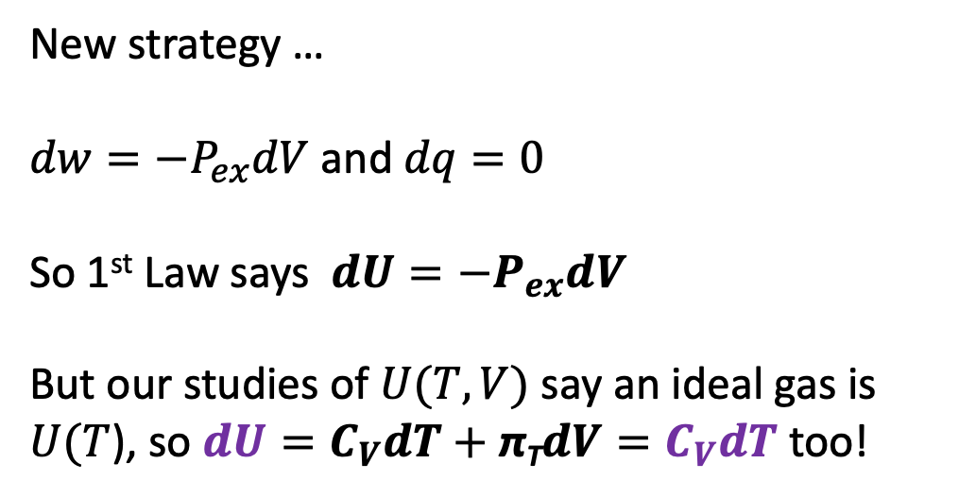






Single-step adiabatic expansion of an ideal gas
New strategy …
$dw=−P_{ex}dV$ and $dq=0$
So 1st Law says $dU=−P_{ex}dV$
But our studies of $U(T,V)$ say an ideal gas is $U(T$), so $dU=C_{V}dT+$ π_{T}$dV=C_{V}dT$ too!
$$U(T,V)$$
V
$$P_{ex}$$
T
$$P_{ex}$$
$$P_{2},V_{2}$$
$$T_{2}$$
$$P_{1},V_{1}$$
$$T_{1}$$
$$P_{ex}$$
No heat going in/out
Temperature is going down
$$dV$$
$$V$$

Slide 9

Single-step adiabatic expansion of an ideal gas
New strategy …
$dw=−P_{ex}dV$ and $dq=0$
So 1st Law says $dU=−P_{ex}dV$
But our studies of $U(T,V)$ say an ideal gas is $U(T$), so $dU=C_{V}dT+$ π_{T}$dV=C_{V}dT$ too!
Put them together!
$$−P_{ex}dV=C_{V}dT$$
Call it an ideal gas!
$$−\frac{nRT}{V}dV=C_{V}dT$$
$$U(T,V)$$
V
$$P_{ex}$$
T
$$P_{ex}$$
$$P_{2},V_{2}$$
$$T_{2}$$
$$P_{1},V_{1}$$
$$T_{1}$$
$$P_{ex}$$
No heat going in/out
Temperature is going down
$$dV$$
$$V$$

Slide 10

Single-step adiabatic expansion of an ideal gas
Solve for this:
$$\frac{1}{T}dT=…$$
$$U(T,V)$$
V
$$P_{ex}$$
T
$$P_{ex}$$
$$P_{2},V_{2}$$
$$T_{2}$$
$$P_{1},V_{1}$$
$$T_{1}$$
$$P_{ex}$$
No heat going in/out
Temperature is going down
$$dV$$
$$V$$

Slide 11

Single-step adiabatic expansion of an ideal gas
Solve for this:
$$\frac{1}{T}dT=−\frac{nR}{C_{V}} \frac{1}{V}dV$$
$$U(T,V)$$
V
$$P_{ex}$$
T
$$P_{ex}$$
$$P_{2},V_{2}$$
$$T_{2}$$
$$P_{1},V_{1}$$
$$T_{1}$$
$$P_{ex}$$
No heat going in/out
Temperature is going down
$$dV$$
$$V$$

Slide 12

Single-step adiabatic expansion of an ideal gas
Some interpretation …
$$\frac{1}{T}dT=−\frac{nR}{C_{V}} \frac{1}{V}dV$$
$\frac{1}{V}dV$ is the fractional change in volume. Multiply that by $−\frac{nR}{C_{V}}$ to get the fractional change in temperature! Works with % too.
$$U(T,V)$$
V
$$P_{ex}$$
T
$$P_{ex}$$
$$P_{2},V_{2}$$
$$T_{2}$$
$$P_{1},V_{1}$$
$$T_{1}$$
$$P_{ex}$$
No heat going in/out
Temperature is going down
$$dV$$
$$V$$

Slide 13
Algebra will get you the rest of the way (Friday)
1st Law +adiabatic +ideal gas

Slide 14

Single-step adiabatic expansion of an ideal gas
Example:
Say V increases from 10 -> 11 L
$\frac{1}{V}dV=0.1$ (or $10\%$)
If an ideal diatomic gas,
$\frac{nR}{C_{V}}=\frac{R}{\frac{7}{2}R}=\frac{2}{7}$
Then $\frac{1}{T}dT=−\frac{nR}{C_{V}} \frac{1}{V}dV$ says
$$\frac{1}{T}dT=−\frac{2}{7}×10\%=3\%$$
Like 300 K -> 291 K
$$U(T,V)$$
V
$$P_{ex}$$
T
$$P_{ex}$$
$$P_{2},V_{2}$$
$$T_{2}$$
$$P_{1},V_{1}$$
$$T_{1}$$
$$P_{ex}$$
No heat going in/out
Temperature is going down
$$dV$$
$$V$$

Slide 15
Algebra will get you the rest of the way (Friday)
?

Slide 16


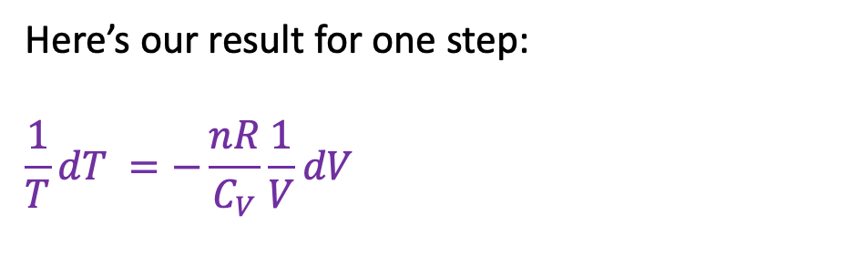


Multi-step adiabatic expansion of an ideal gas
Here’s our result for one step:
$$\frac{1}{T}dT =−\frac{nR}{C_{V}}\frac{1}{V}dV$$
$$U(T,V)$$
V
$$P_{ex}$$
T
$$P_{ex}$$
$$P_{2},V_{2}$$
$$T_{2}$$
$$P_{1},V_{1}$$
$$T_{1}$$
$$P_{ex}$$
No heat going in/out
Temperature is going down
$$P_{Ideal}=nRT/V$$
$$V_{1}$$
$$V_{2}$$

Slide 17


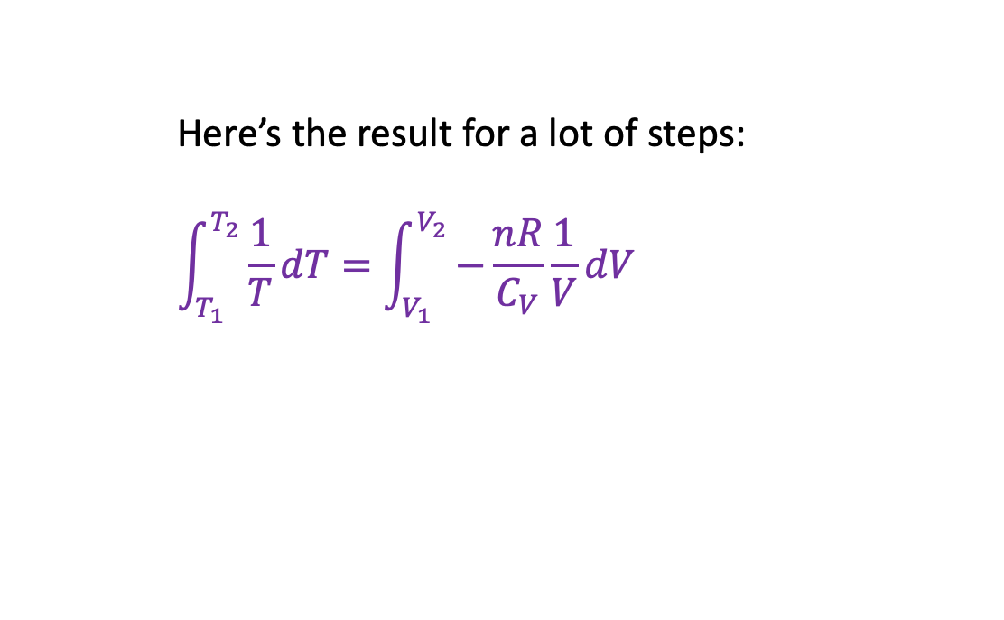


Multi-step adiabatic expansion of an ideal gas
Here’s the result for a lot of steps:
$$\int_{T_{1}}^{T_{2}}{\frac{1}{T}dT}=\int_{V_{1}}^{V_{2}}{−\frac{nR}{C_{V}}\frac{1}{V}dV}$$
$$U(T,V)$$
V
$$P_{ex}$$
T
$$P_{ex}$$
$$P_{2},V_{2}$$
$$T_{2}$$
$$P_{1},V_{1}$$
$$T_{1}$$
$$P_{ex}$$
No heat going in/out
Temperature is going down
$$P_{Ideal}=nRT/V$$
$$V_{1}$$
$$V_{2}$$

Slide 18
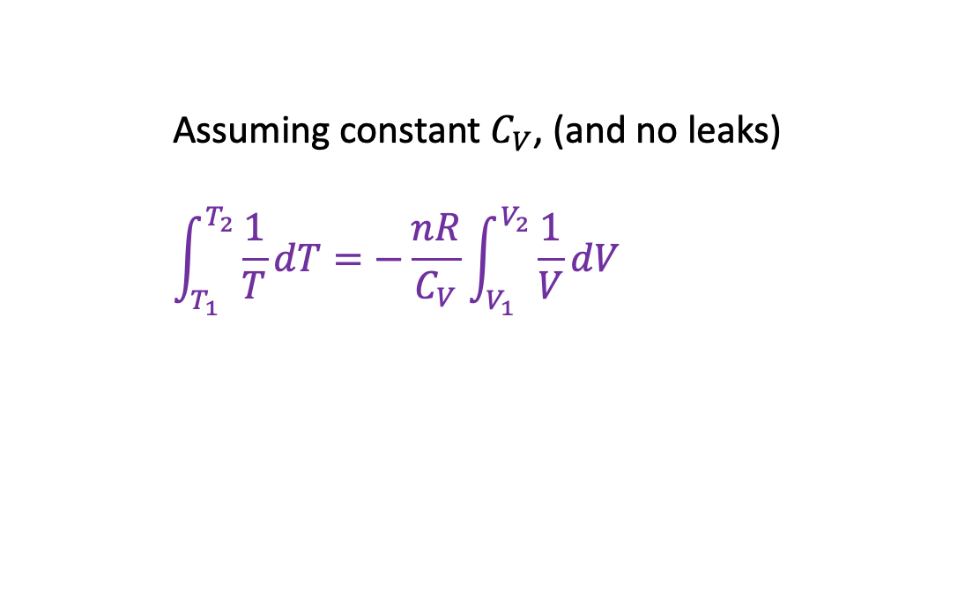
Multi-step adiabatic expansion of an ideal gas
Assuming constant $C_{V}$, (and no leaks)
$$\int_{T_{1}}^{T_{2}}{\frac{1}{T}dT}=−\frac{nR}{C_{V}}\int_{V_{1}}^{V_{2}}{\frac{1}{V}dV}$$
$$U(T,V)$$
V
$$P_{ex}$$
T
$$P_{ex}$$
$$P_{2},V_{2}$$
$$T_{2}$$
$$P_{1},V_{1}$$
$$T_{1}$$
$$P_{ex}$$
No heat going in/out
Temperature is going down
$$P_{Ideal}=nRT/V$$
$$V_{1}$$
$$V_{2}$$

Slide 19

Multi-step adiabatic expansion of an ideal gas
Here’s some calculus …
$$\int_{T_{1}}^{T_{2}}{\frac{1}{T}dT}=−\frac{nR}{C_{V}}\int_{V_{1}}^{V_{2}}{\frac{1}{V}dV}$$
$$U(T,V)$$
V
$$P_{ex}$$
T
$$P_{ex}$$
$$P_{2},V_{2}$$
$$T_{2}$$
$$P_{1},V_{1}$$
$$T_{1}$$
$$P_{ex}$$
No heat going in/out
Temperature is going down
$$P_{Ideal}=nRT/V$$
$$V_{1}$$
$$V_{2}$$

Slide 20
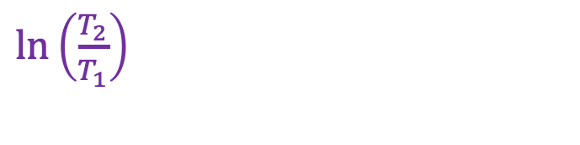
Multi-step adiabatic expansion of an ideal gas
Here’s some calculus …
$$\int_{T_{1}}^{T_{2}}{\frac{1}{T}dT}=−\frac{nR}{C_{V}}\int_{V_{1}}^{V_{2}}{\frac{1}{V}dV}$$
$$U(T,V)$$
V
$$P_{ex}$$
T
$$P_{ex}$$
$\ln\left(\frac{T_{2}}{T_{1}}\right)$
$$P_{2},V_{2}$$
$$T_{2}$$
$$P_{1},V_{1}$$
$$T_{1}$$
$$P_{ex}$$
No heat going in/out
Temperature is going down
$$P_{Ideal}=nRT/V$$
$$V_{1}$$
$$V_{2}$$

Slide 21

Multi-step adiabatic expansion of an ideal gas
Here’s some more calculus …
$$\int_{T_{1}}^{T_{2}}{\frac{1}{T}dT}=−\frac{nR}{C_{V}}\int_{V_{1}}^{V_{2}}{\frac{1}{V}dV}$$
$$U(T,V)$$
V
$$P_{ex}$$
T
$$P_{ex}$$
$\ln\left(\frac{T_{2}}{T_{1}}\right)$
$$P_{2},V_{2}$$
$$T_{2}$$
$$P_{1},V_{1}$$
$$T_{1}$$
$$P_{ex}$$
No heat going in/out
Temperature is going down
$$P_{Ideal}=nRT/V$$
$$V_{1}$$
$$V_{2}$$

Slide 22
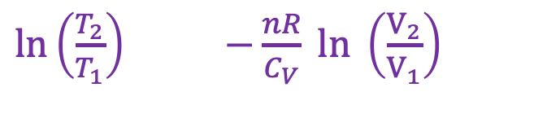
Multi-step adiabatic expansion of an ideal gas
Here’s some more calculus …
$$\int_{T_{1}}^{T_{2}}{\frac{1}{T}dT}=−\frac{nR}{C_{V}}\int_{V_{1}}^{V_{2}}{\frac{1}{V}dV}$$
$$U(T,V)$$
V
$$P_{ex}$$
T
$$P_{ex}$$
$\ln\left(\frac{T_{2}}{T_{1}}\right)$ $−\frac{nR}{C_{V}} ln \left(\frac{V_{2}}{V_{1}}\right)$
$$P_{2},V_{2}$$
$$T_{2}$$
$$P_{1},V_{1}$$
$$T_{1}$$
$$P_{ex}$$
No heat going in/out
Temperature is going down
$$P_{Ideal}=nRT/V$$
$$V_{1}$$
$$V_{2}$$

Slide 23
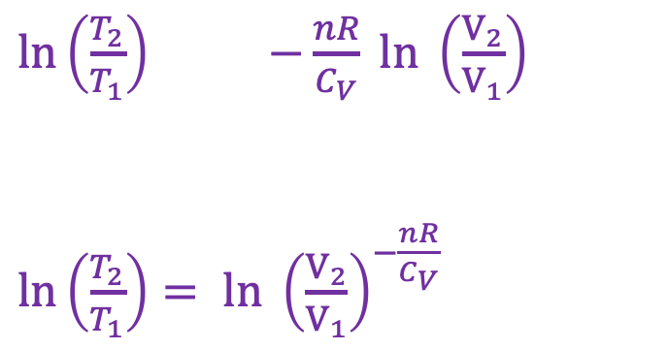

Multi-step adiabatic expansion of an ideal gas
Here’s a fancy log thing
$$\int_{T_{1}}^{T_{2}}{\frac{1}{T}dT}=−\frac{nR}{C_{V}}\int_{V_{1}}^{V_{2}}{\frac{1}{V}dV}$$
$$U(T,V)$$
V
$$P_{ex}$$
T
$$P_{ex}$$
$\ln\left(\frac{T_{2}}{T_{1}}\right)$ $−\frac{nR}{C_{V}} ln \left(\frac{V_{2}}{V_{1}}\right)$
$\ln\left(\frac{T_{2}}{T_{1}}\right)= ln {\left(\frac{V_{2}}{V_{1}}\right)}^{−\frac{nR}{C_{V}}}$
$$P_{2},V_{2}$$
$$T_{2}$$
$$P_{1},V_{1}$$
$$T_{1}$$
$$P_{ex}$$
No heat going in/out
Temperature is going down
$$P_{Ideal}=nRT/V$$
$$V_{1}$$
$$V_{2}$$

Slide 24
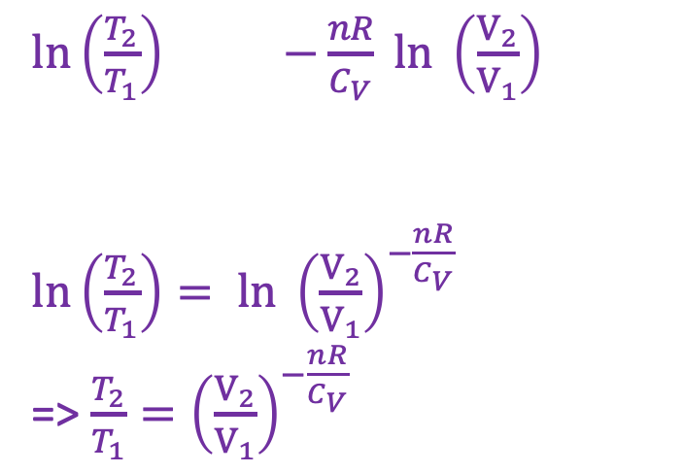

Multi-step adiabatic expansion of an ideal gas
Here’s some more algebra
$$\int_{T_{1}}^{T_{2}}{\frac{1}{T}dT}=−\frac{nR}{C_{V}}\int_{V_{1}}^{V_{2}}{\frac{1}{V}dV}$$
$$U(T,V)$$
V
$$P_{ex}$$
T
$$P_{ex}$$
$\ln\left(\frac{T_{2}}{T_{1}}\right)$ $−\frac{nR}{C_{V}} ln \left(\frac{V_{2}}{V_{1}}\right)$
$\ln\left(\frac{T_{2}}{T_{1}}\right)= ln {\left(\frac{V_{2}}{V_{1}}\right)}^{−\frac{nR}{C_{V}}}$
=> $\frac{T_{2}}{T_{1}}={\left(\frac{V_{2}}{V_{1}}\right)}^{−\frac{nR}{C_{V}}}$
$$P_{2},V_{2}$$
$$T_{2}$$
$$P_{1},V_{1}$$
$$T_{1}$$
$$P_{ex}$$
No heat going in/out
Temperature is going down
$$P_{Ideal}=nRT/V$$
$$V_{1}$$
$$V_{2}$$

Slide 25
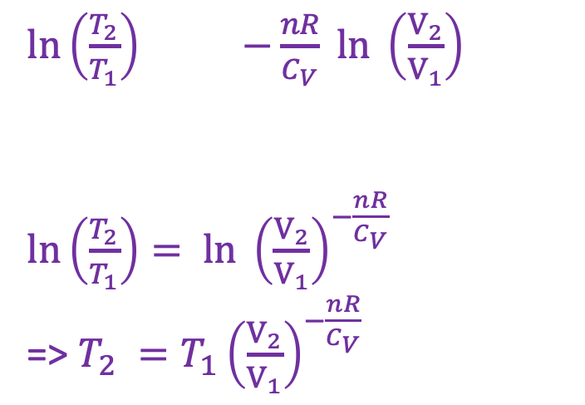

Multi-step adiabatic expansion of an ideal gas
We are just so clever
$$\int_{T_{1}}^{T_{2}}{\frac{1}{T}dT}=−\frac{nR}{C_{V}}\int_{V_{1}}^{V_{2}}{\frac{1}{V}dV}$$
$$U(T,V)$$
V
$$P_{ex}$$
T
$$P_{ex}$$
$\ln\left(\frac{T_{2}}{T_{1}}\right)$ $−\frac{nR}{C_{V}} ln \left(\frac{V_{2}}{V_{1}}\right)$
$\ln\left(\frac{T_{2}}{T_{1}}\right)= ln {\left(\frac{V_{2}}{V_{1}}\right)}^{−\frac{nR}{C_{V}}}$
=> $T_{2} ={T_{1}\left(\frac{V_{2}}{V_{1}}\right)}^{−\frac{nR}{C_{V}}}$
$$P_{2},V_{2}$$
$$T_{2}$$
$$P_{1},V_{1}$$
$$T_{1}$$
$$P_{ex}$$
No heat going in/out
Temperature is going down
$$P_{Ideal}=nRT/V$$
$$V_{1}$$
$$V_{2}$$

Slide 26
Multi-step adiabatic expansion of an ideal gas
We are just so clever
$$\int_{T_{1}}^{T_{2}}{\frac{1}{T}dT}=−\frac{nR}{C_{V}}\int_{V_{1}}^{V_{2}}{\frac{1}{V}dV}$$
$$U(T,V)$$
V
$$P_{ex}$$
T
$$P_{ex}$$
$\ln\left(\frac{T_{2}}{T_{1}}\right)$ $−\frac{nR}{C_{V}} ln \left(\frac{V_{2}}{V_{1}}\right)$
$\ln\left(\frac{T_{2}}{T_{1}}\right)= ln {\left(\frac{V_{2}}{V_{1}}\right)}^{−\frac{nR}{C_{V}}}$
=> $T_{2} ={T_{1}\left(\frac{V_{2}}{V_{1}}\right)}^{−\frac{nR}{C_{V}}}$
$$P_{2},V_{2}$$
$$T_{2}$$
$$P_{1},V_{1}$$
$$T_{1}$$
$$P_{ex}$$
No heat going in/out
Temperature is going down
$$P_{Ideal}=nRT/V$$
$$V_{1}$$
$$V_{2}$$

Slide 27
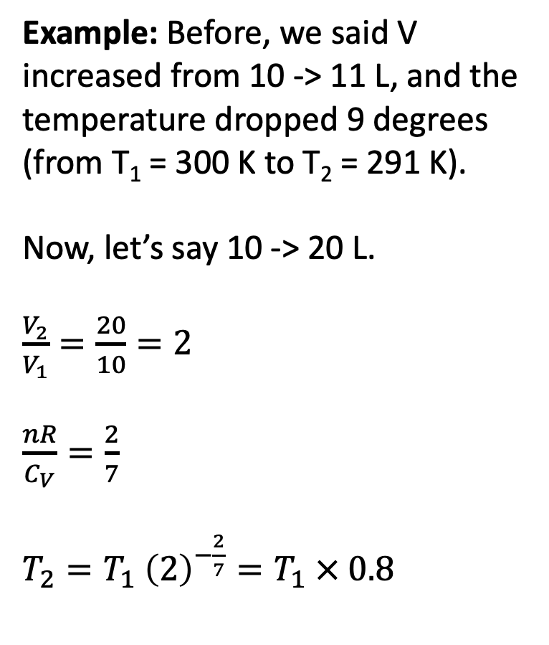
Multi-step adiabatic expansion of an ideal gas
Example: Before, we said V increased from 10 -> 11 L, and the temperature dropped 9 degrees (from T₁ = 300 K to T₂ = 291 K).
Now, let’s say 10 -> 20 L.
$\frac{V_{2}}{V_{1}}=\frac{20}{10}=2$
$\frac{nR}{C_{V}}=\frac{2}{7}$
$T_{2}=T_{1} {\left(2\right)}^{−\frac{2}{7}}=T_{1} × 0.8$
$$U(T,V)$$
V
$$P_{ex}$$
T
$$P_{ex}$$
$$P_{2},V_{2}$$
$$T_{2}$$
$$P_{1},V_{1}$$
$$T_{1}$$
$$P_{ex}$$
No heat going in/out
Temperature is going down
$$P_{Ideal}=nRT/V$$
$$V_{1}$$
$$V_{2}$$

Slide 28
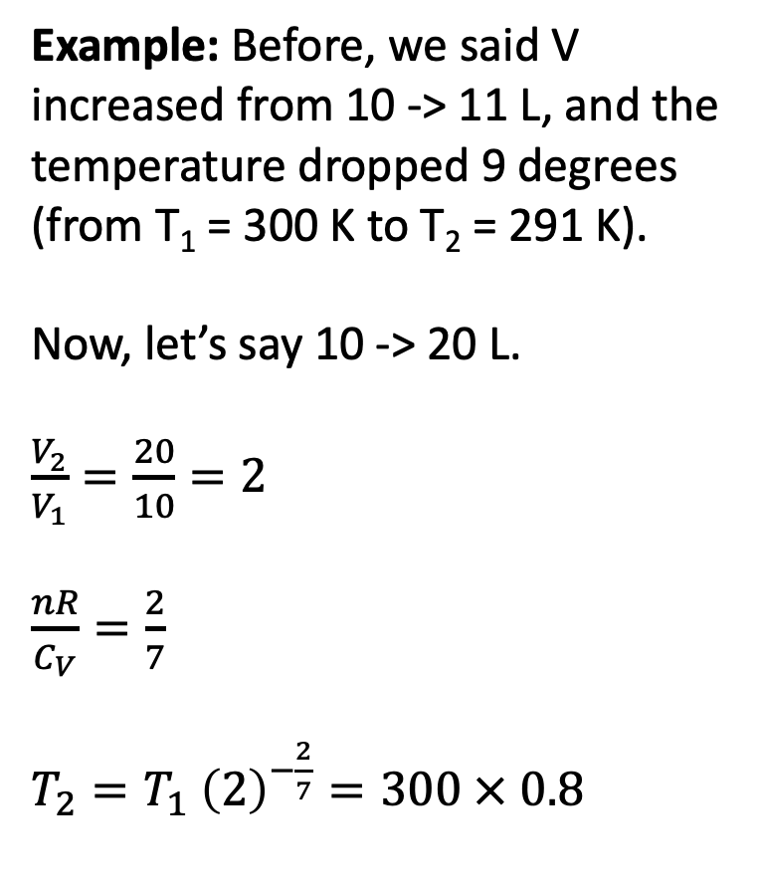
Multi-step adiabatic expansion of an ideal gas
Example: Before, we said V increased from 10 -> 11 L, and the temperature dropped 9 degrees (from T₁ = 300 K to T₂ = 291 K).
Now, let’s say 10 -> 20 L.
$\frac{V_{2}}{V_{1}}=\frac{20}{10}=2$
$\frac{nR}{C_{V}}=\frac{2}{7}$
$T_{2}=T_{1} {\left(2\right)}^{−\frac{2}{7}}=300 × 0.8$
$$U(T,V)$$
V
$$P_{ex}$$
T
$$P_{ex}$$
$$P_{2},V_{2}$$
$$T_{2}$$
$$P_{1},V_{1}$$
$$T_{1}$$
$$P_{ex}$$
No heat going in/out
Temperature is going down
$$P_{Ideal}=nRT/V$$
$$V_{1}$$
$$V_{2}$$

Slide 29
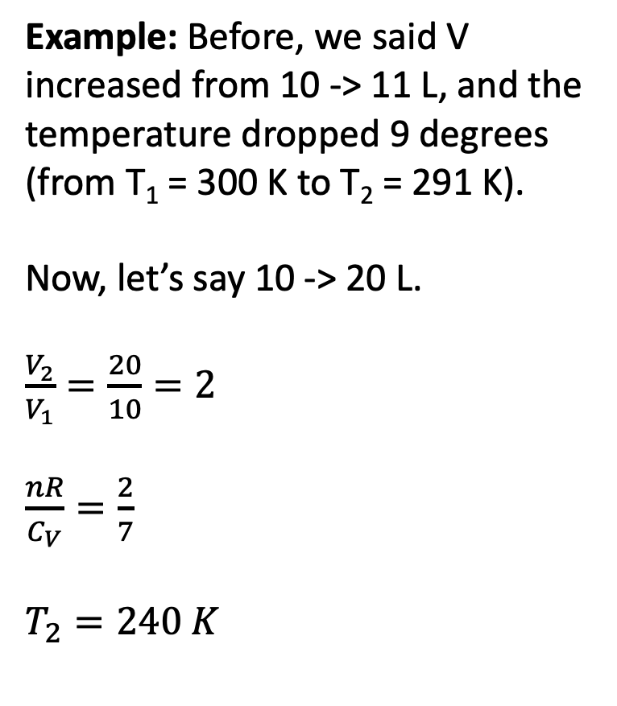
Multi-step adiabatic expansion of an ideal gas
Example: Before, we said V increased from 10 -> 11 L, and the temperature dropped 9 degrees (from T₁ = 300 K to T₂ = 291 K).
Now, let’s say 10 -> 20 L.
$\frac{V_{2}}{V_{1}}=\frac{20}{10}=2$
$\frac{nR}{C_{V}}=\frac{2}{7}$
$T_{2}=240 K$
$$U(T,V)$$
V
$$P_{ex}$$
T
$$P_{ex}$$
$$P_{2},V_{2}$$
$$T_{2}$$
$$P_{1},V_{1}$$
$$T_{1}$$
$$P_{ex}$$
No heat going in/out
Temperature is going down
$$P_{Ideal}=nRT/V$$
$$V_{1}$$
$$V_{2}$$

Slide 30
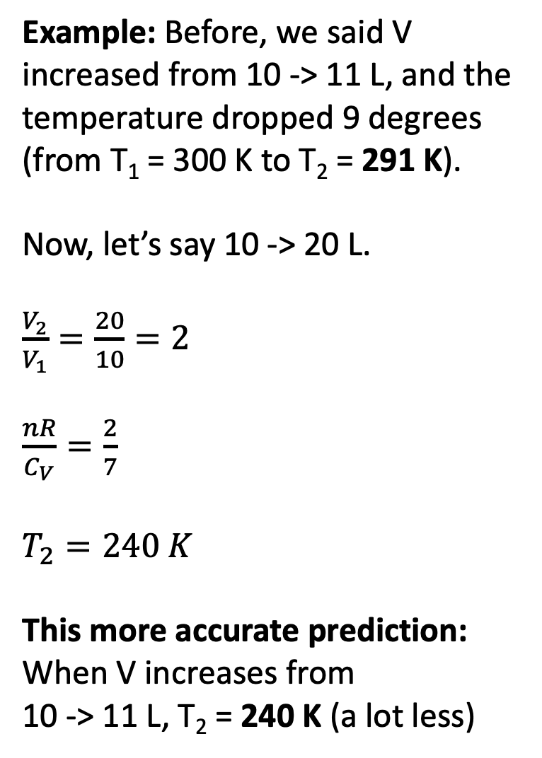
Multi-step adiabatic expansion of an ideal gas
Example: Before, we said V increased from 10 -> 11 L, and the temperature dropped 9 degrees (from T₁ = 300 K to T₂ = 291 K).
Now, let’s say 10 -> 20 L.
$\frac{V_{2}}{V_{1}}=\frac{20}{10}=2$
$\frac{nR}{C_{V}}=\frac{2}{7}$
$T_{2}=240 K$
This more accurate prediction:
When V increases from
10 -> 11 L, T₂ = 240 K (a lot less)
$$U(T,V)$$
V
$$P_{ex}$$
T
$$P_{ex}$$
$$P_{2},V_{2}$$
$$T_{2}$$
$$P_{1},V_{1}$$
$$T_{1}$$
$$P_{ex}$$
No heat going in/out
Temperature is going down
$$P_{Ideal}=nRT/V$$
$$V_{1}$$
$$V_{2}$$

Slide 31
Algebra will get you the rest of the way (Friday)
?

Slide 32
Algebra will get you the rest of the way (Friday)
Calculus, algebra, general cleverness

Slide 33
Algebra will get you the rest of the way (Friday)
Calculus, algebra, general cleverness
More algebra (yeah, Friday)

Slide 34
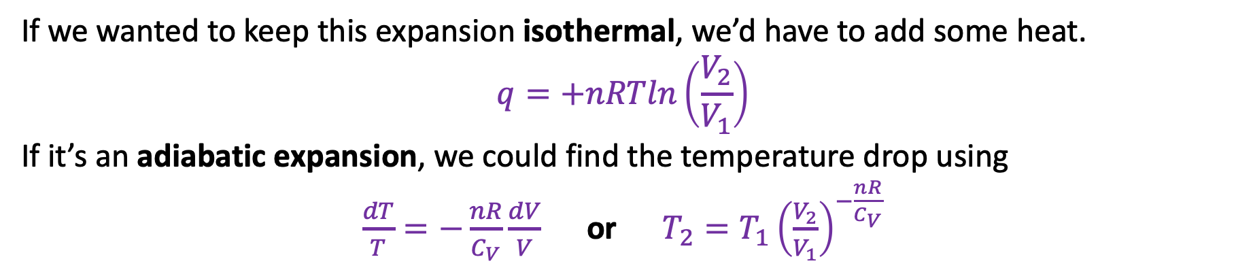
Remember 1st day, on the kinetic-molecular theory of gases?
But when a molecule hits a receding wall, it bounces back more slowly.
Slower-moving molecules correspond to lower temperature.
If we wanted to keep this expansion isothermal, we’d have to add some heat.
$$q=+nRTln\left(\frac{V_{2}}{V_{1}}\right)$$
If it’s an adiabatic expansion, we could find the temperature drop using
$\frac{dT}{T}=−\frac{nR}{C_{V}}\frac{dV}{V}$ or $T_{2}=T_{1}{\left(\frac{V_{2}}{V_{1}}\right)}^{−\frac{nR}{C_{V}}}$

